Slide 1
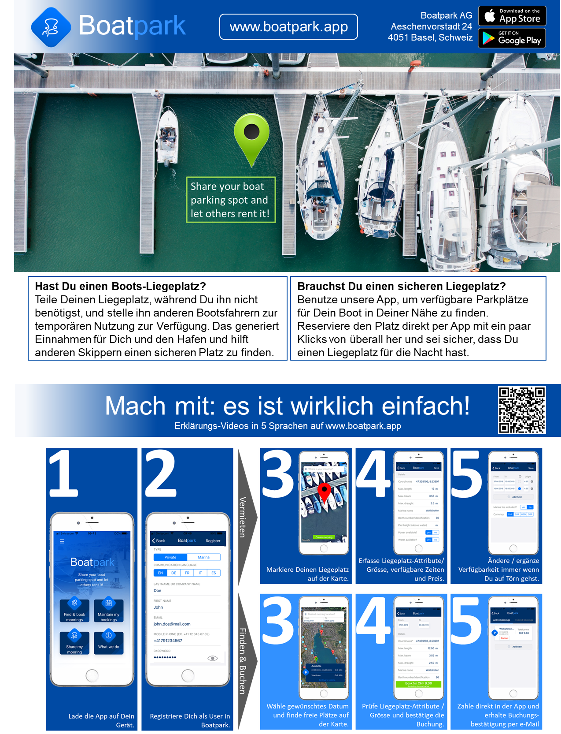
Dein lokaler Boatpark Ambassador: andy.wyss@boatpark.app

